Slide 1
Base de Datos
Mongo DB

Slide 2
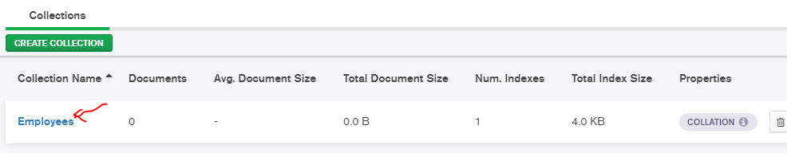
Crear una colección

Slide 3
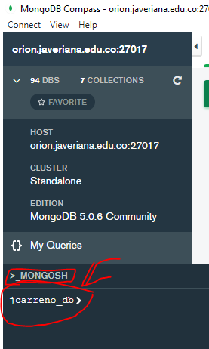
Insertar Documento
Desde el shell, ejecute la siguiente inserción:
db.Employee.insertOne( {"Employeeid" : 1, "EmployeeName" : "Martin", "status", "D" , "qty", "40"})
db.Employee.insertOne( {"Employeeid" : 2, "EmployeeName" : "ernest", "status", "A", "qty", "10"})
db.Employee.insertOne( {"Employeeid" : 3, "EmployeeName" : "luciano", "status", "A", "qty", "20"})
db.Employee.insertOne( {"Employeeid" : 4, "EmployeeName" : "ana rosa", "status", "D", "qty", "30"})
db.Employee.insertOne( {"Employeeid" : 5, "EmployeeName" : "paca", "status", "D", "qty", "50"})

Slide 4
Query
Desde el shell, ejecute las siguientes consultas:
db.Employee.find({})
db.Employee.find({ "Employeeid": {$gt: 1} })

Slide 5
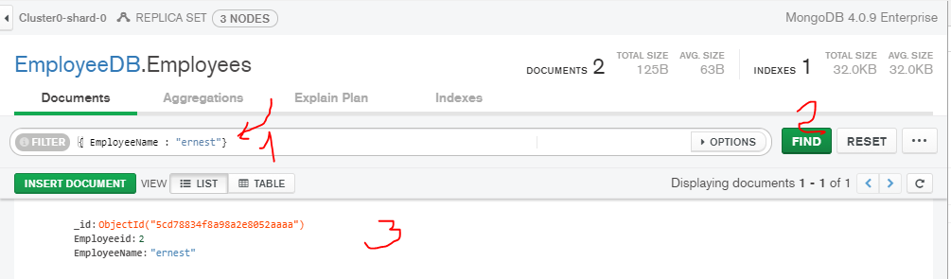
Query
Ejecute las siguientes consultas desde la interfaz gráfica:
1.Debe seleccionar la colección Employee

Slide 6
Query Like
{EmployeeName:/l/}
Sql: like ‘%l%’
{name: /^pa/}
Sql: like 'pa%'
{name: /ro$/}
Sql like '%ro'

Slide 7
Query IN
{ status: { $in: [ "A", "D" ] } }

Slide 8
Query AND
{ status: "A", qty: { $lt: 30 } }

Slide 9
Query OR
{ $or: [ { status: "A" }, { qty: { $lt: 30 } } ] }

Slide 10
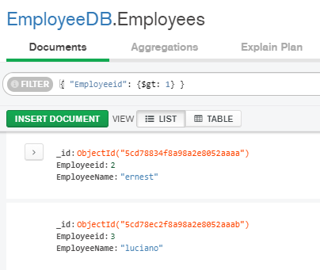
Query
{ "Employeeid": {$gt: 1} }

Slide 11
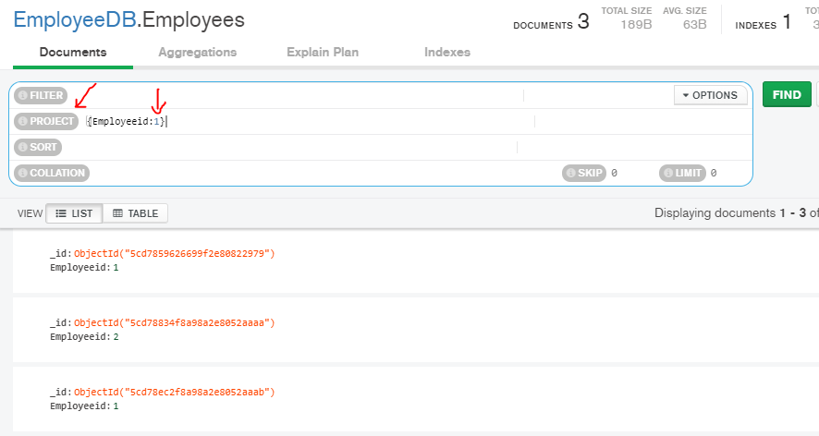
Query Project
1 : incluir, 0 no incluir

Slide 12
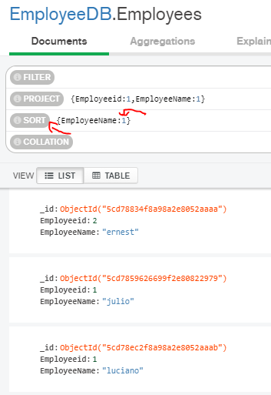
Sort
1: asc; -1: desc

Slide 13
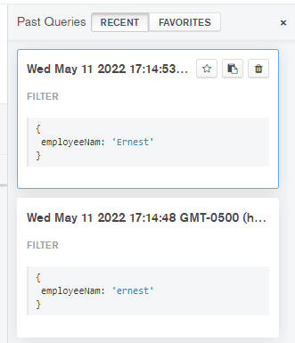
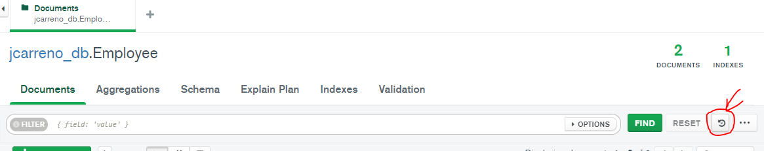
Muestre su trabajo
Llame al profesor y muestre su trabajo

Slide 14
Referencias
https://docs.mongodb.com/compass/current/
https://docs.mongodb.com/stitch/tutorials/guides/blog-web/
https://stitch.mongodb.com/groups/5cd5d6f1c56c98c292c16d24/apps/5cd7a78fbd1443956361beeb/clusters/5cd7a7918e232ac4f9f1e64d/rules/5cd7aa92bd14439563620895
https://www.guru99.com/mongodb-query-document-using-find.html

